Slide 1
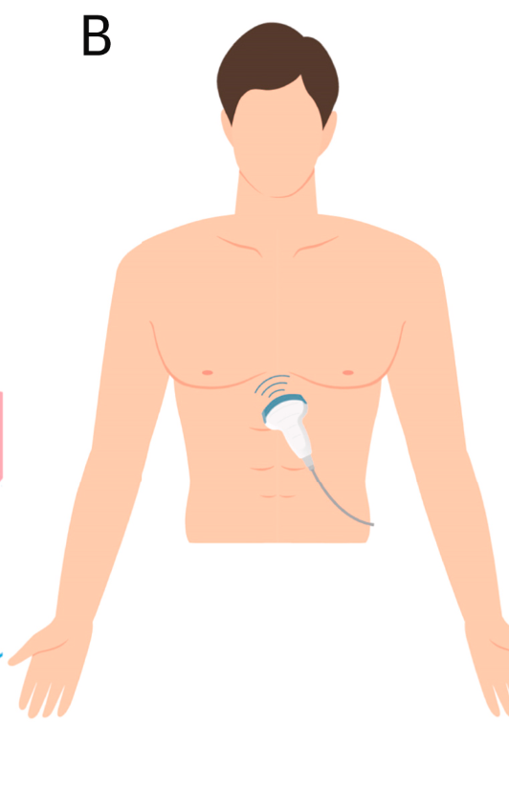
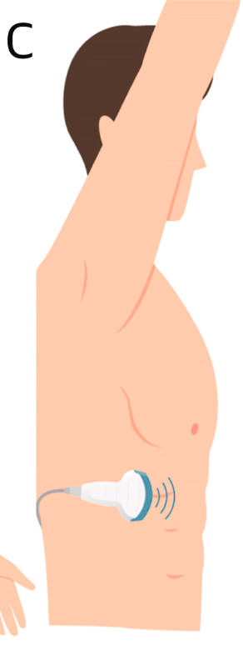
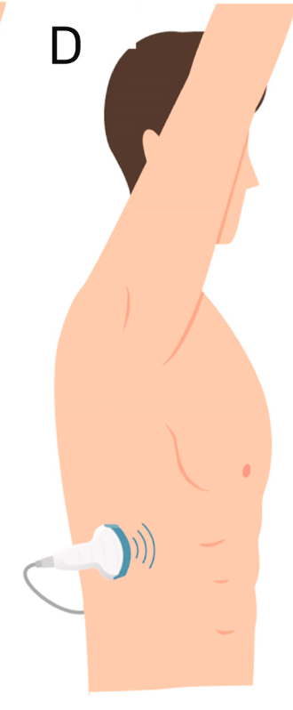
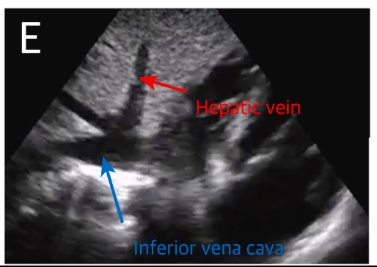
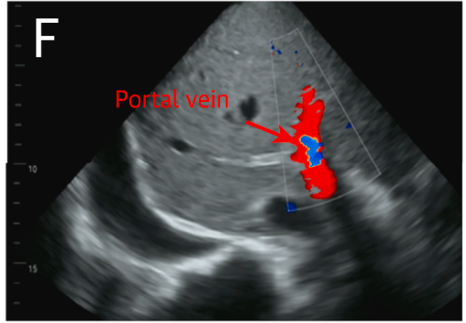
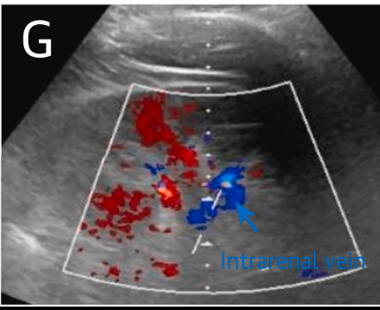
VExUS = venous excess ultrasonography
along the anterior axillary line, tilting the tip of the probe slightly to anterior.
The intrarenal veins can be evaluated by placing the probe along the midaxillary line with the tip in a superior–posterior position.
both the hepatic and portal veins can be visualized simultaneously by means of a clockwise rotation of the probe.

Slide 2
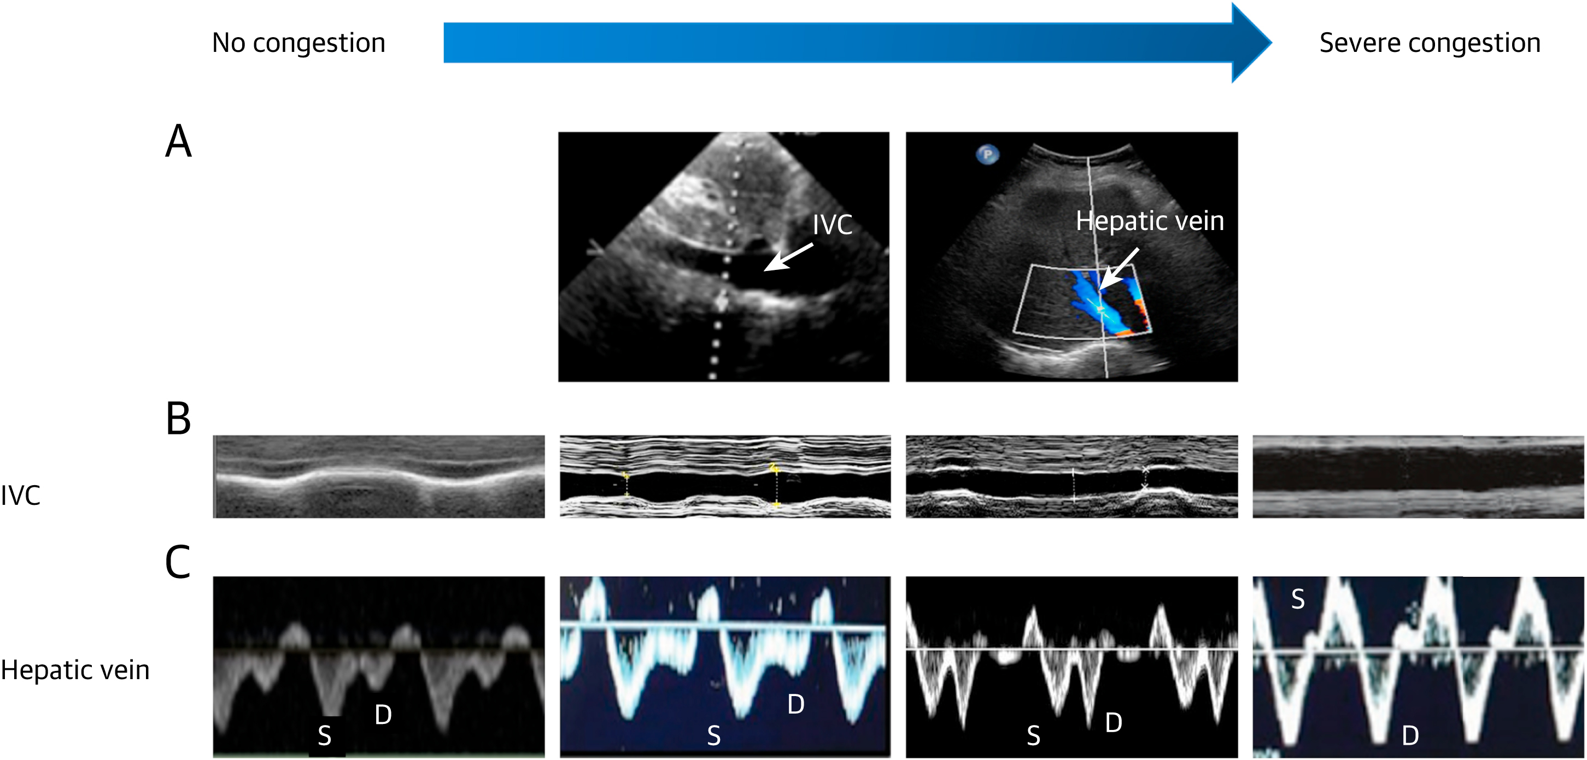
The size of the IVC increases and the respiratory variability reduces with progressive venous congestion. PW Doppler assessment of the hepatic vein in a patient without congestion shows a S and D component with S > D. With progressive venous congestion, the S/D ratio reverses (S < D), and eventually the systolic component reverses.
PW
S= systolic D= diastolic

Slide 3
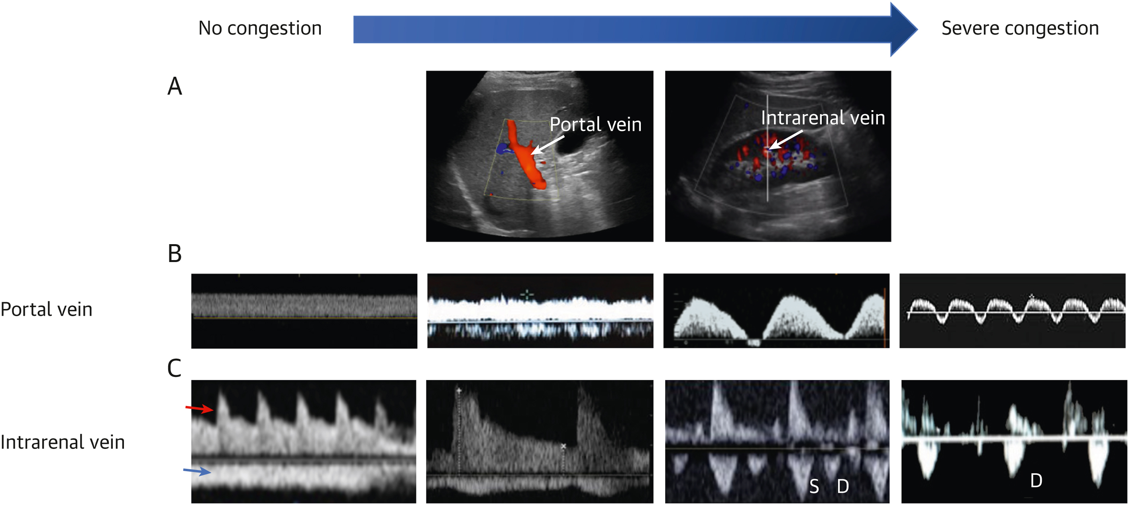
PW Doppler assessment of the portal vein in a patient without congestion shows a continuous, nonpulsatile flow above the baseline. With progressive venous congestion, the flow becomes pulsatile and flow reversal can occur during systole in patients with severe congestion.
Pulsed wave Doppler assessment of the intrarenal vein also shows a continuous, nonpulsatile flow, but below the baseline (blue array). With progressive venous congestion, the flow becomes pulsatile and biphasic, showing separate S and D waves.
intrarenal arterial waveform
intrarenal vein

Slide 4
PV PW ultrasound

