Slide 1
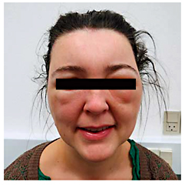

How Not to Be Misled by Disorders Mimicking Angioedema: A Review of Pseudoangioedema
Int Arch Allergy Immunol 2016;169:163-170 - DOI:10.1159/000445835
© 2016 S. Karger AG, Basel
Notes:
Fig. 1. Acute contact dermatitis with severe facial swelling after hair dyeing.

Slide 2
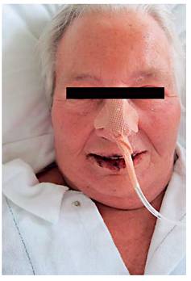
How Not to Be Misled by Disorders Mimicking Angioedema: A Review of Pseudoangioedema
Int Arch Allergy Immunol 2016;169:163-170 - DOI:10.1159/000445835
© 2016 S. Karger AG, Basel
Notes:
Fig. 2. Generalized edematous swelling and morbilliform rash in a patient with DRESS.

Slide 3
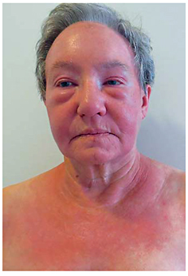
How Not to Be Misled by Disorders Mimicking Angioedema: A Review of Pseudoangioedema
Int Arch Allergy Immunol 2016;169:163-170 - DOI:10.1159/000445835
© 2016 S. Karger AG, Basel
Notes:
Fig. 3. Heliotrope rash and edema and rash in the shawl area in a patient with dermatomyositis.

Slide 4
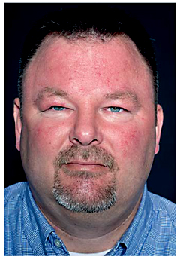
How Not to Be Misled by Disorders Mimicking Angioedema: A Review of Pseudoangioedema
Int Arch Allergy Immunol 2016;169:163-170 - DOI:10.1159/000445835
© 2016 S. Karger AG, Basel
Notes:
Fig. 4. Persistent swelling of the forehead, cheeks and upper eyelids in a patient with Morbus Morbihan.

Slide 5
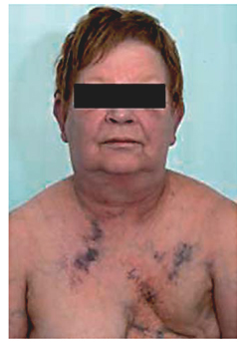
How Not to Be Misled by Disorders Mimicking Angioedema: A Review of Pseudoangioedema
Int Arch Allergy Immunol 2016;169:163-170 - DOI:10.1159/000445835
© 2016 S. Karger AG, Basel
Notes:
Fig. 5. Facial and neck swelling accompanied by dilatation of veins and cyanosis in a patient with superior vena cava syndrome. Photo credit: Tarec Christoffer El-Galaly, MD, and Nina Keldsen, MD, reprinted with permission [Ugeskr L&#x00E6;ger 2007;169:3118].

Slide 6
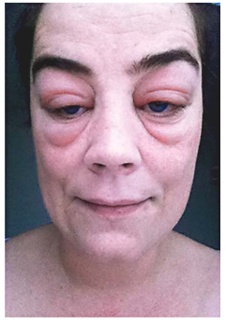
How Not to Be Misled by Disorders Mimicking Angioedema: A Review of Pseudoangioedema
Int Arch Allergy Immunol 2016;169:163-170 - DOI:10.1159/000445835
© 2016 S. Karger AG, Basel
Notes:
Fig. 6. Severe manifestation of periorbital edema in a patient with hypothyroidism.

Slide 7
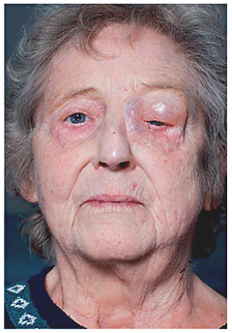
How Not to Be Misled by Disorders Mimicking Angioedema: A Review of Pseudoangioedema
Int Arch Allergy Immunol 2016;169:163-170 - DOI:10.1159/000445835
© 2016 S. Karger AG, Basel
Notes:
Fig. 7. Subcutaneous emphysema with severe swelling of the left chin, eyelids and neck after a simple dental procedure.

Slide 8
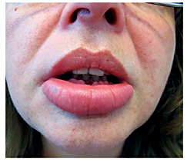
How Not to Be Misled by Disorders Mimicking Angioedema: A Review of Pseudoangioedema
Int Arch Allergy Immunol 2016;169:163-170 - DOI:10.1159/000445835
© 2016 S. Karger AG, Basel
Notes:
Fig. 8. Persistent swelling of the lower lip in a patient with orofacial granulomatosis.

Slide 9
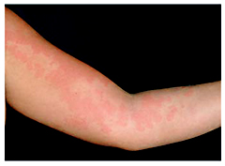
How Not to Be Misled by Disorders Mimicking Angioedema: A Review of Pseudoangioedema
Int Arch Allergy Immunol 2016;169:163-170 - DOI:10.1159/000445835
© 2016 S. Karger AG, Basel
Notes:
Fig. 9. Edematous urticarial plaques in a patient with hypocomplementemic urticarial vasculitis syndrome.

Slide 10
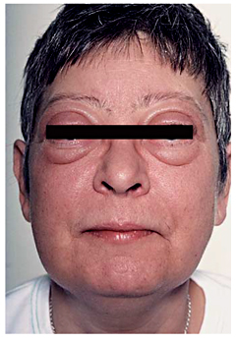
How Not to Be Misled by Disorders Mimicking Angioedema: A Review of Pseudoangioedema
Int Arch Allergy Immunol 2016;169:163-170 - DOI:10.1159/000445835
© 2016 S. Karger AG, Basel
Notes:
Fig. 10. Generalized edematous swelling in a patient with Clarkson's disease. Photo credit: Knud Bonnet Yderstr&#x00E6;de, MD.

Slide 11

How Not to Be Misled by Disorders Mimicking Angioedema: A Review of Pseudoangioedema
Int Arch Allergy Immunol 2016;169:163-170 - DOI:10.1159/000445835
© 2016 S. Karger AG, Basel
Notes:
Fig. 11. Characteristic left periorbital edema and partial ptosis, with left conjunctival injection and tear formation during a cluster headache attack. Photo credit: Horton Hovedpineforening (Danish Association for Patients with Cluster Headache), www.hortonforeningen.dk.

Slide 12
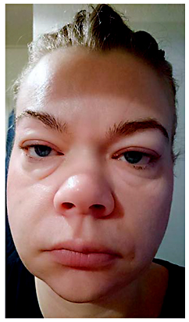
How Not to Be Misled by Disorders Mimicking Angioedema: A Review of Pseudoangioedema
Int Arch Allergy Immunol 2016;169:163-170 - DOI:10.1159/000445835
© 2016 S. Karger AG, Basel
Notes:
Fig. 12. Fluid retention of the face in a patient with idiopathic edema.

